Slide 1
Problem Overview
Context Paragraph :In 1870, Tesla moved to Karlovac, to attend school at the Higher Real Gymnasium, where he was profoundly influenced by a math teacher Martin Sekulić.:32 The classes were held in German, as it was a school within the Austro-Hungarian Military Frontier. Tesla was able to perform integral calculus in his head, which prompted his teachers to believe that he was cheating. He finished a four-year term in three years, graduating in 1873.:33
Question : What could Tesla perform in his head ?
Answer : Integral Calculus
Question : When did Tesla go to Karlovac
Answer : 1870

Slide 2
Data Comprehension:
We used SQuAD(Stanford Question Answering Dataset) for our Machine Comprehension Task.
The dataset is composed of 100000+ question asked by crowd-workers on a set of selected wikipedia paragraphs. It has been asked to the crowd-workers to ask a question about the text and point the shortest part in the original paragraph that would be a correct answer. The result is a set of 100 000+ triplets of paragraphs Pn, questions Qn, and answers answer.

Slide 3
Data Statistics
 | Max | Mean | Median
Paragraph | 766 | 138 | 126
Question | 60 | 11 | 11
Answers | 46 | 3 | 1
We can see that the paragraph length is heavily skewed so we will need to truncate paragraphs, and make sure the padding and the masking is done correctly.

Slide 4
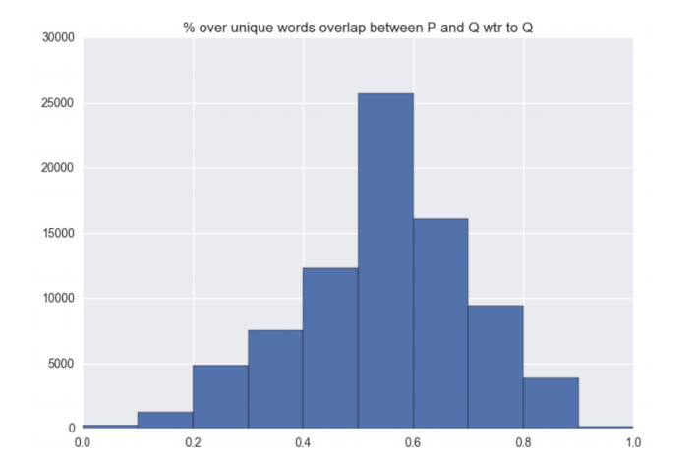
Percentage of unique word overlap between the question and the answer, with respect to the question

Slide 5
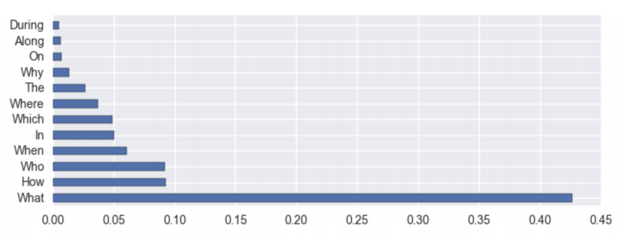
Proportion (truncated) of question by starting word

Slide 6
Model Structure
LSTM Pre- Processing Layer
Match-LSTM Layer
Answer Pointer Layer

Slide 7
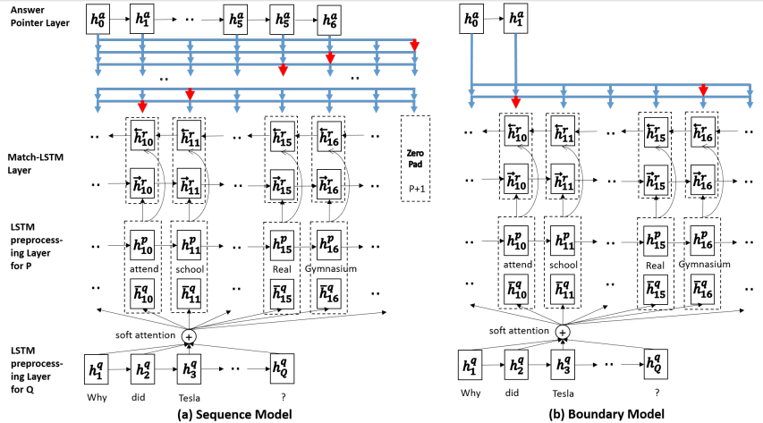

Slide 8

LSTM Pre-Processing Layer
In this layer we incorporate the contextual information into the representation of each token in the passage in the question.
We use a standard one-directional LSTM to process the passage and the question separately.
The resulting matrices Hp ∈ R^{lXP} and Hq ∈ R^{lXQ} are hidden representations of the passage and the question, where l is the dimensionality of the hidden vectors.

Slide 9

Match LSTM Layer
This layer is applied for textual Entailment to our machine comprehension by treating the question as premise and passage as hypothesis.
At position i of the passage, it first uses the standard word-by-word attention mechanism to obtain attention weight vector αi ∈ R^{Q} as follows:
W^{q},W^{p},W^{r} ∈ R^{l×l}, b^{p},w ∈ R^{l} and b ∈ R are the parameters to be learned
h^{r}_{i-1} ∈ R^{l} is the hidden vector of the one-directional Match-LSTM.

Slide 10


Match LSTM Layer
The resulting attention weight αi,j above indicates the degree of matching between the i^{th} token in the passage with the j^{th} token in the question.
we use the attention weight vector αi to obtain a weighted version of the question and combine it with the current token of the passage to form a vector Zi

Slide 11

Match LSTM Layer
We further build a similar match-LSTM in the reverse direction. The purpose is to obtain a representation that encodes the contexts from both directions for each token in the passage.
W^{q},W^{p},W^{r} ∈ R^{l×l}, b^{p},w ∈ R^{l} and b ∈ R are the parameters to be learned which are same as the previous forward match-LSTM.
h^{r}_{i-1} ∈ R^{l} is the hidden vector of the one-directional Match-LSTM.

Slide 12

Match LSTM Layer
Finally from this layer we get output H^{r} which is of dimension R^{2lXp} as the concatenation of the two outputs that we get from the forward and reverse sequential match-LSTM layer.

Slide 13
Answer Pointer Layer
Sequence Model
In the sequence model, the answer is represented by a sequence of integers a = (a1, a2, . . .) indicating the positions of the selected tokens in the original passage.
As length of the answer is not fixed, we add a new column in the H^{r} (output from previous layer) which is denoted by Ĥ^{r}
In order to stop generating answer H^{r} tokens at certain point, we allow each ak to take up an integer value between 1 and P+1, where P+1 is a special value indicating the end of the answer. Once ak is set to be P+1, the generation of the answer stops.

Slide 14

Answer Pointer Layer
Sequence Model
In order to generate the k^{th} answer token indicated by ak, first the attention mechanism is used again to obtain an attention weight vector βk ∈ R^{(P +1)}, where βk,j (1 ≤ j ≤ P+1) is the probability of selecting the j^{th} token from the passage as the k^{th} token in the answer, and β_{k,(P +1)} is the probability of stopping the answer generation at position k.
β_{k} is modeled as follows:
hª_{k−1} ∈ R^{l} is the hidden vector at position k−1 of an answer LSTM as defined below:

Slide 15




Answer Pointer Layer
Sequence Model
Probability of generating the answer sequence is calculated as :
We used the following loss function :

Slide 16
Answer Pointer Layer
Boundary Model
It is similar to sequence model. In this we just predicted the starting and closing index of the answer
We just predicted the span of the answer
Here, we didn’t have to pad the H^{r} with a column as we know the number of indices to be generated.

Slide 17
Future Work
Due to high system requirements we were only able to run our model on 3000 paragraphs on our local machine. In future we will train the model in the cloud. Also ,we have written the code from scratch so have not focused on optimizing it, our next step would be to write it more efficiently.
Also, we would try to debug and determine why our model for Coattention encoder was not able to run.

Slide 18
Difficultlties faced
The main problem during the project was memory limit of our machines. We were not able to run our code for many days due to this limitation. Also we faced some problems in implementation because of unique way of handling data and functions in tensorflow as we have to spend much time even on small things.

Slide 19
References
Pranav Rajpurkar, Jian Zhang, Konstantin Lopyrev, and Percy Liang. SQuAD: 100,000+ questions for machine comprehension of text. In Proceedings of the Conference on Empirical Methods in Natural Language Processing, 2016.
Shuohang Wang and Jing Jiang. Learning natural language inference with LSTM. In Proceedings of the Conference on the North American Chapter of the Association for Computational Linguistics, 2016.
Wang, S. & Jiang, J. (2016) Machine Comprehension using Match-LSTM and Answer Pointer. arXiv: 1608.07905.
https://theneuralperspective.com/2017/01/02/dynamic-coattention-networks-for-question-answering/ ( for images)

